Slide 1


Analysis on the impact of coronavirus on market capitalization of sp500 companies Group 003-001 Ricardo Calleja Jose Toro Patricio Ramirez Cristian Salinas
St. Clair College Fall 2022

Slide 2
CONTENTS
Background / Motivation
Problem statement
Project description
Analysis questions
Dataset description
Method

Slide 3

01.
Background / Motivation.

Slide 4

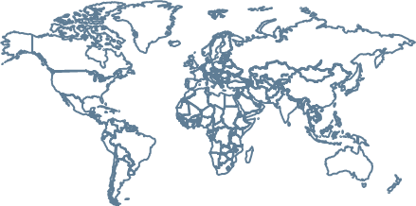
Background / Motivation.
Pandemics are recurrent (Ex. Ebola 2013, Spanish flu 1918), and they had an economic impact. The rise of economic uncertainty during Covid-19 pandemic (Ortmann et al., 2020), increased investment risk. Understanding the trend of economic actors, could be used as a comparison for similar events in the future.
Disclaimer: Even though investment risk augmented during COVID-19, it is not our intention to assure causation.

Slide 5
Background / Motivation.
Since the COVID-19 pandemic was officially declared in January 2020 , it is relevant to analyze data from the year 2019, 2020 and 2021. Considering seasonality effects, the analysis is performed on a quarterly basis.

Slide 6
02.
Problem STATEMENT

Slide 7

”
Investors in SP500 index need to understand tendencies on market capitalization before, and after pandemics, in order to use it as a point of comparison for similar events in the future.
*Before refers to all quarters of 2019. *After refers to all quarters of 2021.

Slide 8
03.
pROJECT description

Slide 9

PROJECT DESCRIPTION
Create a descriptive analysis to comprehend the market capitalization value of the companies that belong to the SP500 index in the year 2019, 2020 and 2021 by quarters.

Slide 10
04.
Analysis Questions

Slide 11

1) How each GICS sector in the sp500 index performed in market capitalization terms FOR THE PERIODs 2021-2020 and 2020-2019? 2) WHICH WAS THE TOP COMPANY in the sp500 index WITH HIGHER POSITIVE MARKET CAPITALIZATION FOR each quarter in the periods 2021-2020 and 2020-2019?

Slide 12
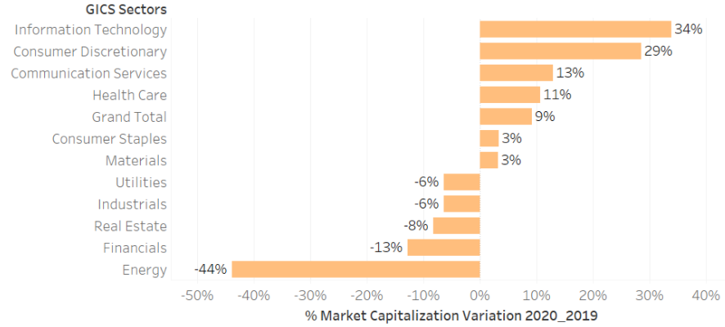
1) How each GICS sector in the sp500 index performed in market capitalization terms FOR THE PERIOD 2020-2019?
For 2020-2019 the GICS sector in the SP500 index with higher positive variation on market capitalization WAS INFORMATION TECHNOLOGY with 34%.

Slide 13
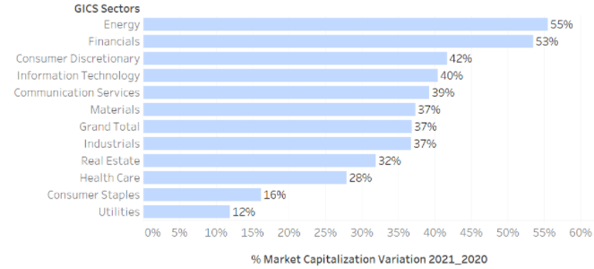
1) How each GICS sector in the sp500 index performed in market capitalization terms for the PERIOD 2021-2020?
For 2021-2020 the GICS sector in the SP500 index with higher positive variation on market capitalization WAS ENERGY with 55%.

Slide 14
2) WHICH WAS THE TOP COMPANY in the sp500 index WITH HIGHER POSITIVE MARKET CAPITALIZATION FOR each quarter in the periods 2021-2020 and 2020-2019?
ENPH = Enphase
TSLA = Tesla
BBWI = Bath & body works
MRNA = Moderna
DVN = devon energy

Slide 15
05.
Dataset Description

Slide 16
Dataset Description
1) The dataset to be used comes from Yahoo Finance API and it includes stock price, share quantity and a description of each company within the SP500.
2) It covers all quarters from 2019, 2020 and 2021.

Slide 17
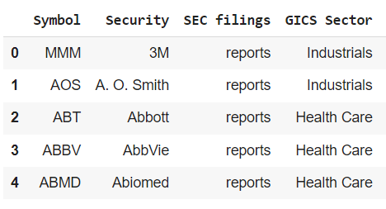
Dataset Description
Symbol: Mnemonic which represents the name of the company.
Security: Fungible and tradable financial instruments used to raise capital in public and private markets.
GICS Sector: Company sector according to Global Industry Classification Standard.

Slide 18
06.
METHOD

Slide 19

METHOD
Merge Dataset
Clean Database
ANALYZE Database
Visualizations
1
2
3
4
Consolidate the datasets: SP500 companies, Shares S&P 500,.
Analyze the data before coming to any assumption
Clean the data that can generate negative effects on the final result

Slide 20
Data Transformation
For each company of the SP500 index we joined the data for the year 2019, 2020 and 2021 by quarters. After this, Market capitalization was calculated (Share price times Share Volume). Additionally, we found Market capitalization variation for the period 2020 vs 2019 and 2021 vs 2020. Finally, the data was also analyzed by GICS sector.

Slide 21
07.
Exploratory Data Analysis (EDA)

Slide 22
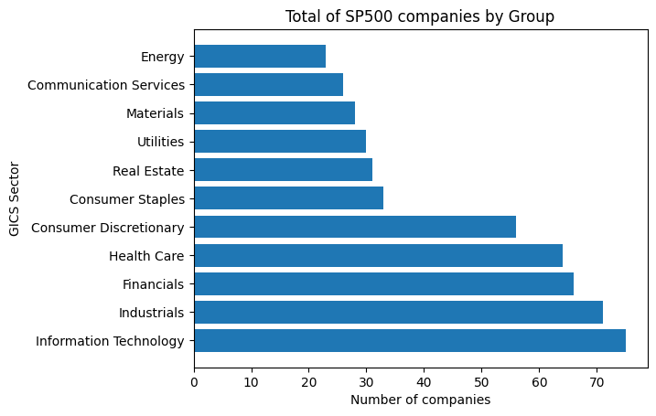
EDA
SP500 index is composed by 503 companies, divided on 11 Sectors, Lead by Information Technology, Industrials and Financial companies.

Slide 23
08.
conclusions

Slide 24
CONCLUSION
As we could see the SP500 has companies that presents activities in 11 different sectors. The sector with the most presence is information technology, followed by industrials and financials. On the contrary, energy is the sector with the fewest number of companies operating in this index.
Regarding the sector that could be highlighted in the market capitalization for the periods 2019-2020, and 2020-2021, we can observe that:
1- For the year 2020, concerning the previous year, the information technology sector was the one that led the list, followed by consumer discretionary and communication on services; the first with 34%, the second with 29%, and the third with 13% increase. On the other hand, the sectors that decreased the most were Real Estate (8%), financials (13%) and energy, with a negative 44%.

Slide 25
CONCLUSION
2- The variation of the year 2021 concerning the previous year, all sectors had positive market capitalization variation, led by energy, financials and consumer discretionary; the first with 55%, the second with 53% and the third with 42% respectively. It should be noted that for this year, most countries began to open borders and reactivate their economy, and it could be seen reflected in the growth and improvement of these companies in economic sectors.
It should be noted that the companies that had a negative effect in 2020 compared to 2019, for the year 2021, had a noticeable growth and recovery; such is the case with the Utilities, Industrial, Real Estate, Finance and Energy sectors.

Slide 26
CONCLUSION
Additionally, when comparing the companies that had the best results by quarter, we were able to observe that Tesla was the company that stood out the most among the periods studied, since by 2020, it was the company that grew the most among the quarter 2 and quarter 4, besides, for the following year, it was the company with the greatest positive variation for the first quarter.

Slide 27
RECOMENDATIONS
According to what was previously observed in our analysis of the impact of coronavirus on the market capitalization of sp500 companies, we can recommend to investors that in the event of events of similar characteristics to the Covid-19 pandemic the following:
1- Do not lose control due to temporary losses. The biggest recoveries usually happen right after big falls.
2- Diversification is a fundamental element of investments. By diversifying an investment it is possible to mitigate or minimize the risks.

Slide 28
REFERENCE
1- Ortmann, R., Pelster, M., & Wengerek, S. T. (2020). COVID-19 and investor behavior. SSRN Electronic Journal. https://doi.org/10.2139/ssrn.3589443

Slide 29
Analysis on the impact of coronavirus on market capitalization of sp500 companies Group 003-001 Ricardo Calleja Jose Toro Patricio Ramirez Cristian Salinas
St. Clair College Fall 2022

